Slide 1

Design and implementation of a robotic system for high precision façade cleaning
Călian alexandru-ștefan
SEMESTER i
SCIENTIFIC COORDINATOR
Prof. Dr. Ing. Stelian brad

Slide 2
4 SEMESTER BREAKDOWN OF THE RESEARCH TOPIC
The research topic is structured on the 4 semesters as it follows:
Getting accustomed with the subject and the current development. Creating a personal solution that incorporates the best ideas out of the existing ones.
Required calculations for developing the structure of the robotic system. Software and programming solutions that need to be developed and integrated.
Recreation of the robot physically or in a simulated environment
Revisiting previous work, adjusting, fixing errors. Bring improvements to current stage of the project

Slide 3
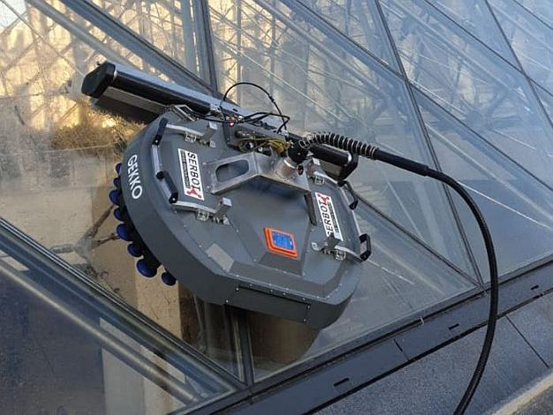
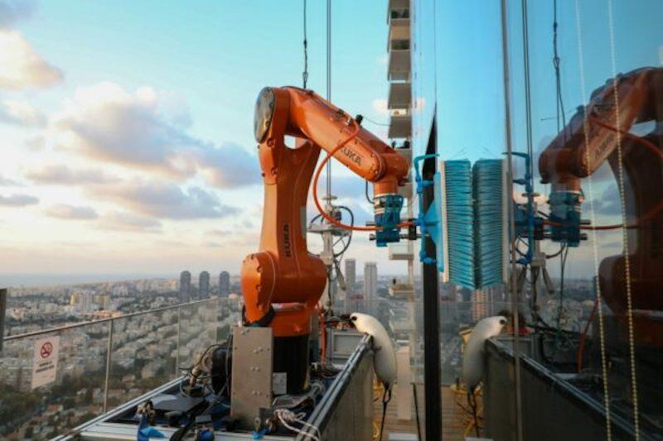
PURPOSE OF THE PROJECT THEME
Development and implementation of a robotization for glass façade cleaning
Notes:
- The robotic cleaning solutions are on rise because of the benefits that it brings compared to manual labour façade cleaning, that involves certain risks, and is not that time efficient
- A lot of existing businesses are converting to automated solutions because of this

Slide 4

PROBLEMS TO BE SOLVED IN THE CURRENT SEMESTER
Getting accustomed with the current situation in the development phase of such robotization systems
Present the important solutions in developing such a system

Slide 5
THE STEPS FOLLOWED IN THE CURRENT SEMESTER DEVELOPMENT
Introduction to the subject
Presenting the benefits of robotized cleaning reported to manual labor
Underlining the differences between solutions
Semi automated solutions VS Fully automated solutions
Process of thought when choosing a solution
Underline the main components taken into consideration when designing a façade glass cleaning robot
Present the solutions that are currently developed
Considering the current solutions
Present the chosen solution for each main component
Support the selection

Slide 6
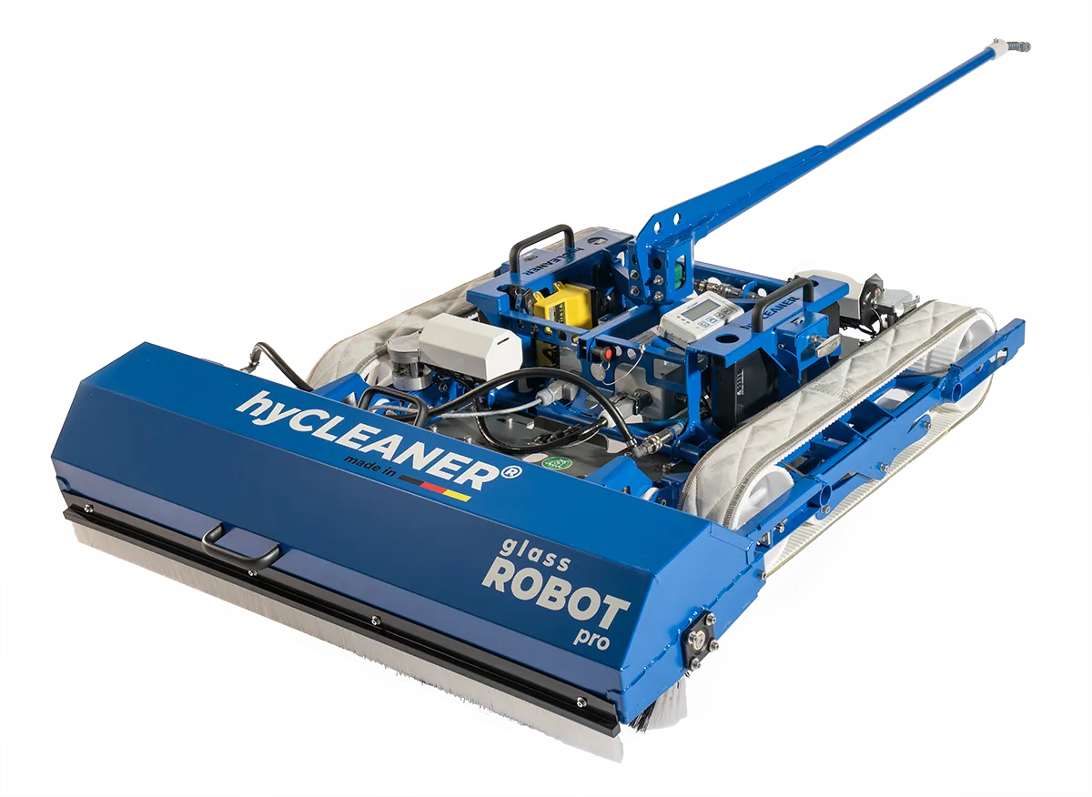
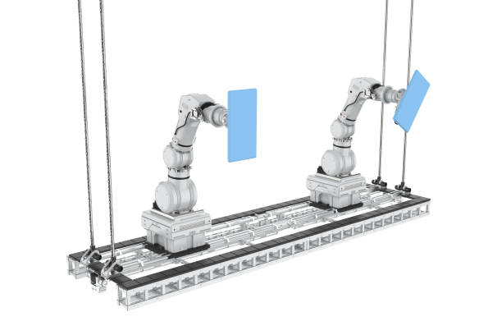
Robotized façade cleaning
Safe, no risk of injury
Profitable on the long run
Precise, faster, better
Lower maintenance cost
Futureproof
Notes:
- Robotized façade cleaning is on the rise because of the following advantages when compared to other cleaning solutions.
- Safe, presents no risk of injury because no working force is involved. Personnel is used only for monitoring the process or controlling the robots remotely in the case of some solutions.
- When compared to human working force it is more precise, faster and better from every aspect when talking about reaching difficult spots or increasing the quality of the service considerably.
- Even if the initial cost is greater than employing workers, it has a lower maintenance cost than the working force.
- Because of all these aspects is futureproof , especially because it is being developed consistently.

Slide 7

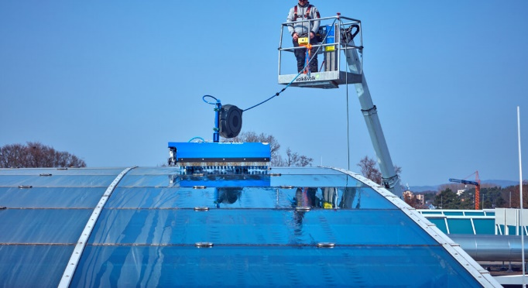
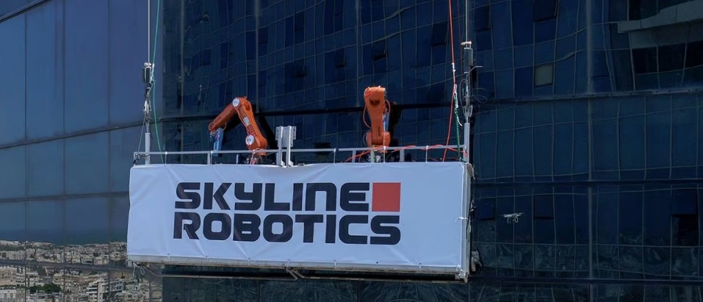
Semi – automated and Fully automated robotic solutions
Semi – automated
Fully automated
Controlled remotely
Guided by the operator
Limited communication range
No assistance required
Automatically collects data
Micro controller/pre defined path
Notes:
- Controlled remotely from a short distance using a teleoperated device
- Automatically collects data and re calculates its path for high precision in glass cleaning
- In the case of cleaning solutions that involve robotic arms we have a micro controller which executes the programming phase while also communicating with the other devices, sensors and vision systems in order to execute the task/OR/ The dimensions of the surface that needs to be cleaner are already know and it already has a pre – existed defined path that has been programmed into it.

Slide 8
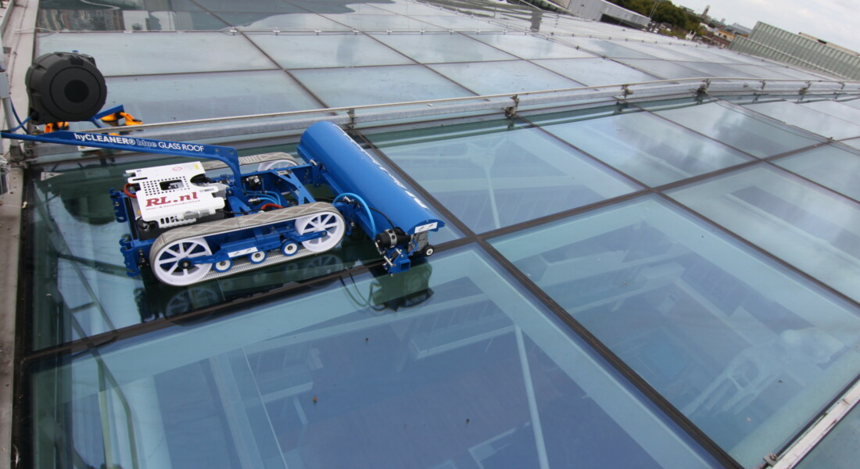
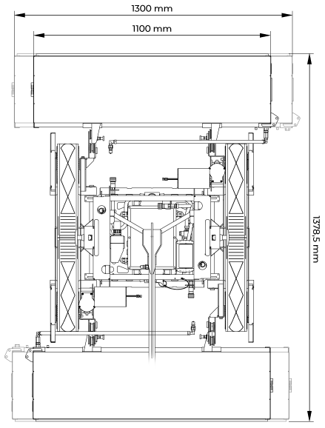
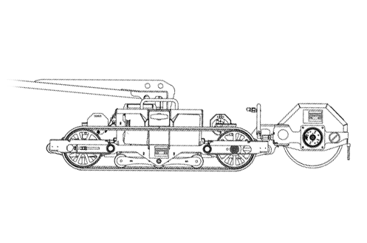
Robotic systems currently in development
Semi – automated glass cleaning robot
ECO- friendly, reduced consumption of water
Easy to control and learn
Cleans stepper surfaces, up to 30 degrees
Notes:
- consumes 8 liters per minute, x20 times less than conventional high – pressure cleaning systems
- cleans up to 2400 square meters/ hour
- the cleaning system consists of a cylindrical roll with fine bristles that rotates, being constantly lubrified by water.
- Main disadvantage is that it can only clean roof, so it’s not a façade cleaning robot, but it was worth mentioning because the working principle and mechanism is identical to one. It can be transformed into a façade cleaning robot by installing a adhesion mechanism which can keep it attached to the wall.

Slide 9
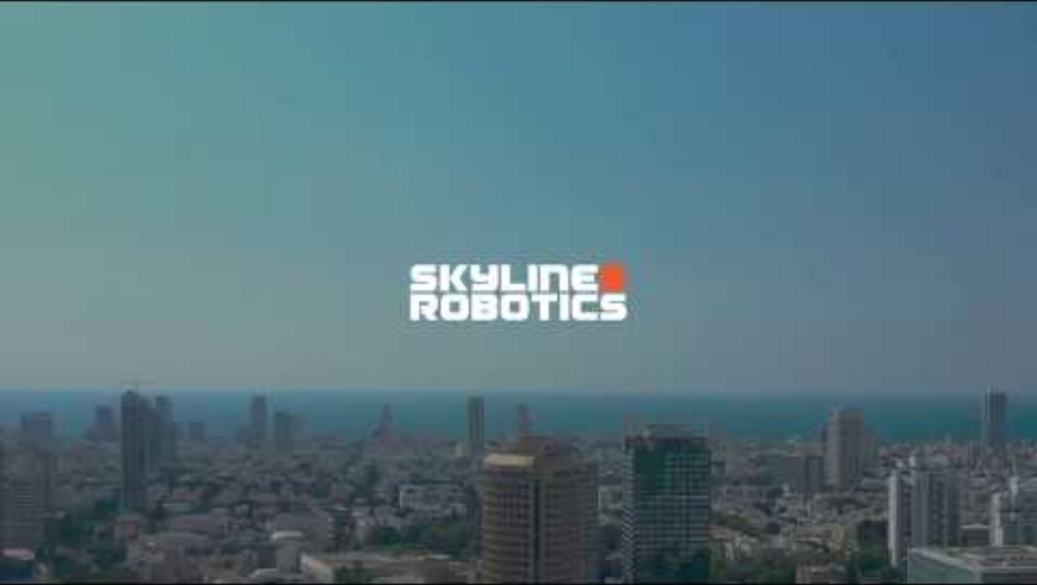
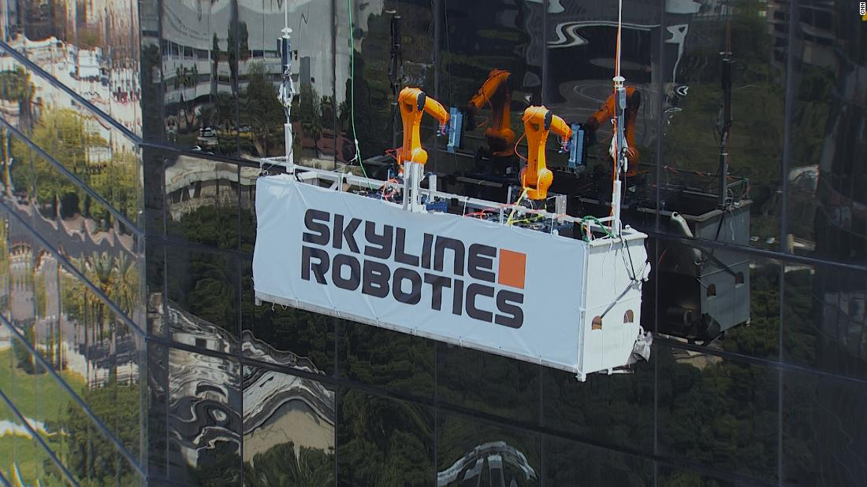
Robotic systems currently in development
Fully automated façade glass cleaning robot
Robotic arm robot KR Agilus
Replicates hand movements
Pressure force sensors
Lidar camera for collecting data
Real-time path recalculation
Notes:
- It is the only solution that involves the use of robotic arms, on the market, developed by Skyline Robotics, a KUKA brand that has been created in order to develop automated robot systems for high façade glass cleaning.
- The robotic arm used is KR Agilus, 6-axis robot system that has been chosen because of its high resistance to the environment, especially being waterproof.

Slide 10
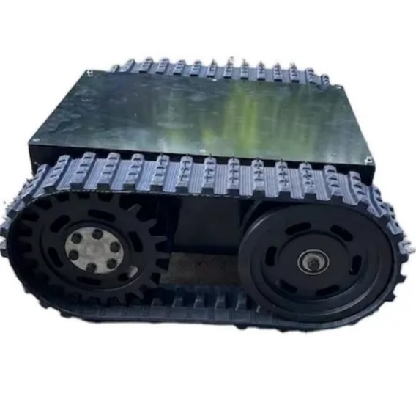
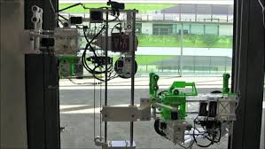
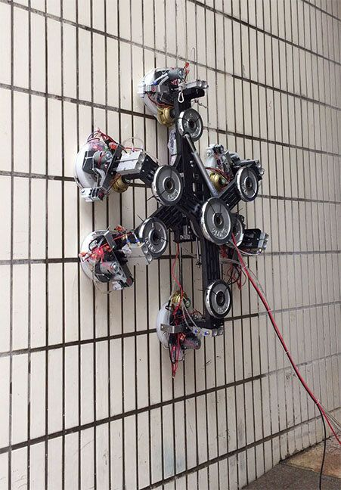
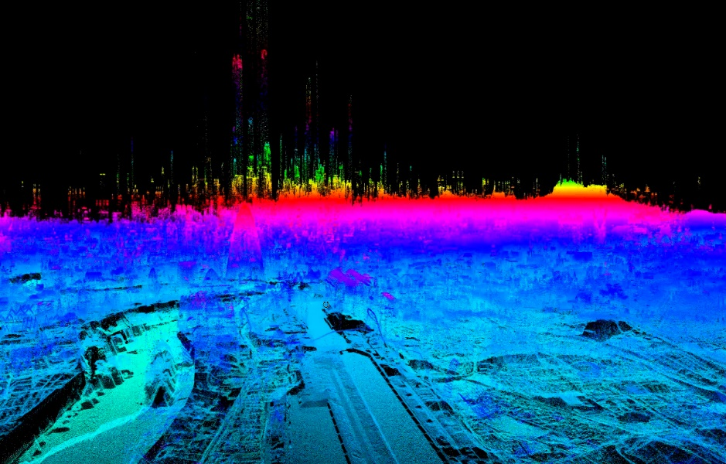
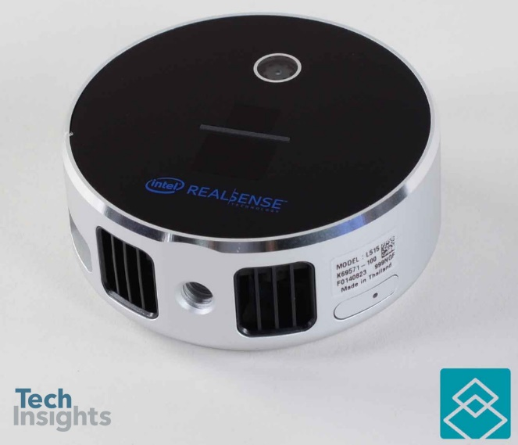
Considering the current solutions
Locomotion mechanism
Adhesion techniques
Instruments for data collection
Notes:
- After studying the current development we need to take into consideration the available solutions for each robotic system component, while choosing the best one.
- We need to choose first a locomotion mechanism that is needed in order for the robot to navigate the glass surface.
The caterpillar tracks could be a very good solution especially if they are made from a soft material like rubber or silicone so the glass is not scratched by the robot’s movements.
- A adhesion mechanism needs to be used in order to make sure that the robot is attached to the surface.
A pneumatic solution would be the best choice, a vacuum cup system that is controlled by a solenoid valve which generates and dissipates the active vacuum in them.
- Instruments for data collection are also very important, especially the lidar (light detection and ranging) camera that is used to generate a 3D map of the surrounding, used in conjunction with artificial intelligence to calculate and recalculate the robot path cleaning while avoiding obstacles.
Pressure force sensor and vacuum sensors are also crucial in controlling the force with which the robot cleans the glass, respectively, the level of vacuum in the cups, so that the glass is not damaged and the robot can move freely on the surface while being secured to the glass.

Slide 11
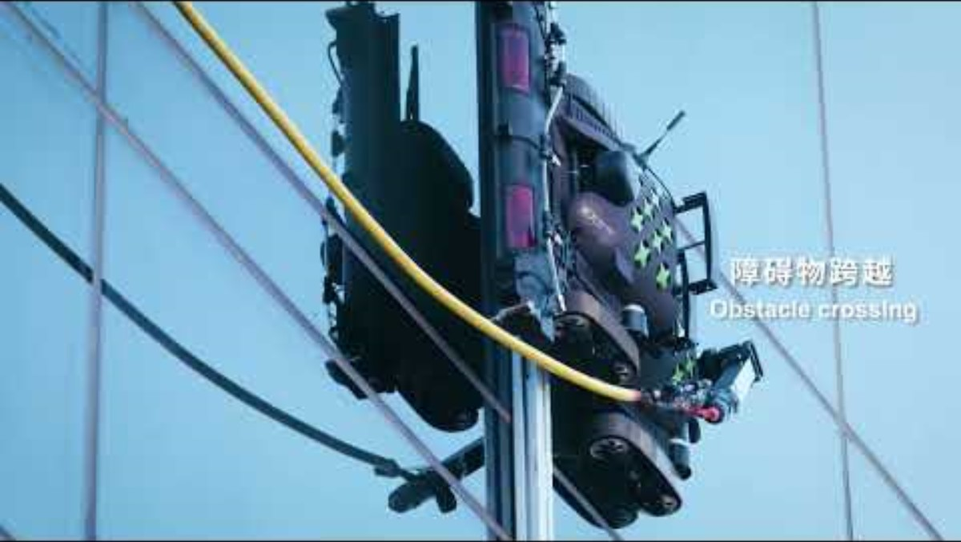
Considering the current solutions
Notes:
- A solution that needs to be taken into consideration regarding the movement of the robot is by integrating the concept of nested reconfigurable robots. The concept aims to develop robots that can be applied to autonomous facade cleaning on buildings with various types of architecture or different types of structures that can limit the movement of the robot or restrict it at all.
- Because the typical facade cleaning robots work on flat glass panels that are connected by frames, they need to clean the windows according to the frame shape.
The concept achieves autonomous cleaning according to window shapes, while using multiple modular multilegged robots capable of reconfiguring their morphology based on window shapes, which is executed by transforming their own module or connecting with each other and letting the robots cooperate.
The extension is most likely achieved through the use of linear actuators.
They can represent a economic advantage because such robotic systems can potentially lower overall robot cost by making a range of complex machines out of a single type of mass-produced modules.

Slide 12
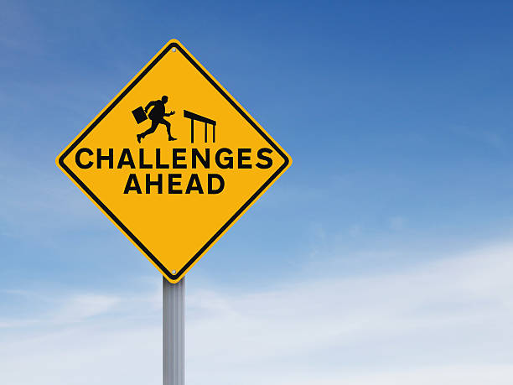
MAJOR CHALLENGES IN THE CURRENT SEMESTER
Gathering information regarding the subject
Understanding the thought of process when designing this kind of robots.
Understanding the technologies used in the development

Slide 13

CONCLUSIONS
The automation of façade glass cleaning is continuously rising
There are different solutions for different types of complexity
The cost is greater and raported to the degree of automation

Slide 14


